Slide 1
29/03/2022
Title: Substitution
Aim:
Be able to
simplify expressions
Evaluate expressions through substitution
Plan:
Daily review
Defining evaluate
Simplify expressions
Independent practice.
Need whiteboards

Slide 2
The word is
Evaluate
Substitute pronumerals and solve for a numerical answer.
Other words:
Replace letters and get an answer as a number.

Slide 3
Substitution
Copy examples into exercise books.
If x = 4 and y = 3, Simplify then evaluate:
x + y =
2x + 4 + y =
9x + 3 – 2x =
8 – 5x – 1 =
9b – 1 + 8y – 8b + 3 =

Slide 4
Whiteboards
If x = 3 and y = 7, simplify THEN evaluate these expressions:
7x + 7 – 2x =
3x + 7y + 2x – 3y + 6 =
2x – (–3x) + 6
9y + (–7y) + 3x =

Slide 5
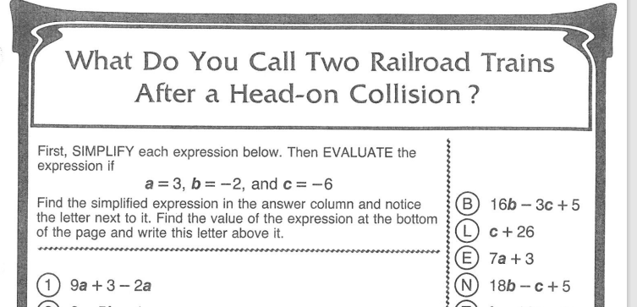
Independent practice.
Questions may be completed on the worksheet. Substitutions do not need to be completed.

Slide 6
Reflection
Aim:
Be able to
simplify expressions
Evaluate expressions through substitution

